Slide 1
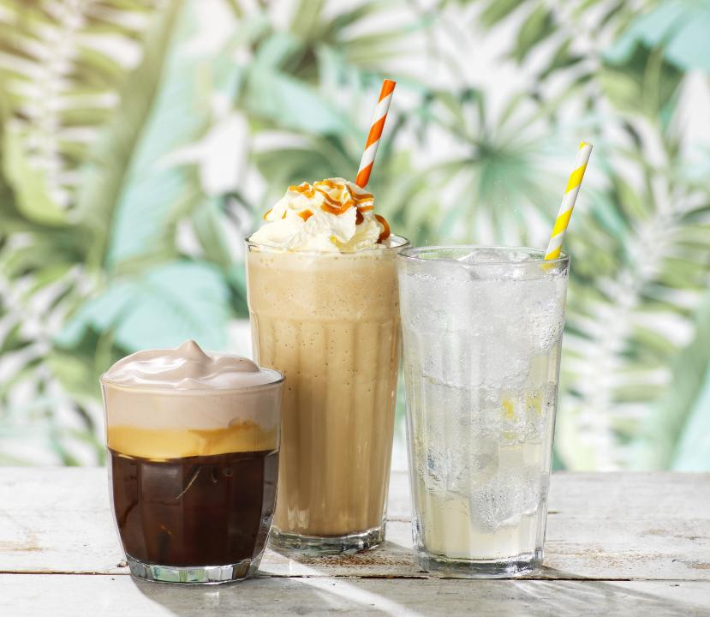



I:\Marketing\Presentations\Cold Drinks 2025
THE ULTIMATE
Cold Drinks Solutions for Coffee Shops

Slide 2
01
05
Why Your Cold Drinks
Menu Matters
What Our Partners Say
02
06
Addressing Common Coffee
Shop Challenges
We Are
Beyond the Bean
AGENDA
03
07
Beyond the Bean
Solves These Pain Points
Summary
04
Award Winning Brands

Slide 3


Why Your
Cold Drinks Menu Matters
Confidential ©Beyond the Bean 2025

Slide 4
Market trends
Beyond Coffee:
Why Your Cold Drinks Menu Matters
19%
demand more iced
drinks flavours. ²
Milkshakes, smoothies, and iced teas are growing categories.¹
Cold drinks drive higher profit margins than traditional coffee offerings.
56%
70%
of UK coffee shop
customers want to see more innovation in coffee shop
iced drinks. ³
of coffee shop menus consist of non-coffee beverages.
81%
of under 35s add syrup sometimes or often.²
25%
of UK customers buy
iced drinks even in winter.
*Sources: (1) World Coffee Portal: Cakes Shakes and Tea Breaks, 2024. (2) Beyond the Bean; Menu research of the UK’s Top 20 Coffee Shops by Number of Outlets; December 2024 ; (3) Straits Research 2024-2033. Confidential ©Beyond the Bean 2025

Slide 5
Market trends
Beyond Coffee:
Blended and Iced Drinks are in growth
Which of the following iced beverages have you purchased out-of-home over the last 12 months?
43.4%
2023
41.3%
37.5%
38.8%
2024
24.2%
19.7%
Milkshake
Smoothie
Iced Juice
*Source: World Coffee Portal: Cakes Shakes and Tea Breaks, 2024. Confidential ©Beyond the Bean 2025

Slide 6
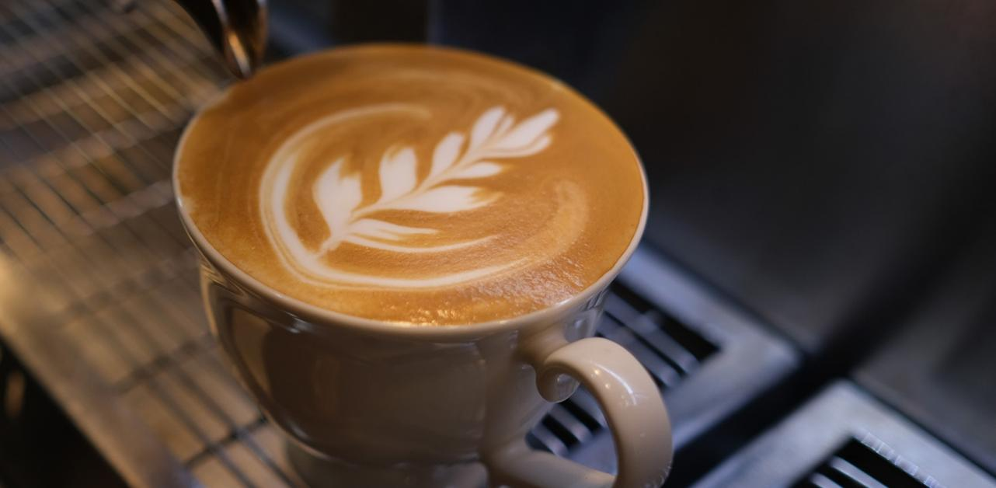
Addressing Common
coffee shop challenges
Confidential ©Beyond the Bean 2025

Slide 7
Common Challenges that Coffee Shops Face
The Cold Drink Gap
LACK OF VERSATILITY:
OPERATIONAL COMPLEXITY:
LOW
PROFITABILITY:
SUSTAINABILITY CHALLENGES:
Limited Menu,
Limited Appeal
Slow Service, Inconsistent Results
High Costs,
Missed Opportunities
Excess Waste, Inefficient Storage
Many coffee shops
focus heavily on coffee, overlooking high-margin
cold drinks.
Rigid menus that don’t evolve with customer preferences limit revenue opportunities.
Made to order cold drinks are perceived to require complex preparation.
Inconsistent drink quality leads to customer dissatisfaction and
lost repeat business.
Many shops struggle
with expensive fresh ingredients which involve regular buying/restocking, washing, prepping, and often waste.
Missed upselling opportunities due to lack
of customisation options.
Many cold drink ingredients come in waste-heavy RTD packaging (ready to drink), which is single use plastic cans or bottles that require refrigeration.
Refrigeration demands increase energy costs
and carbon footprint.
Confidential ©Beyond the Bean 2025

Slide 8
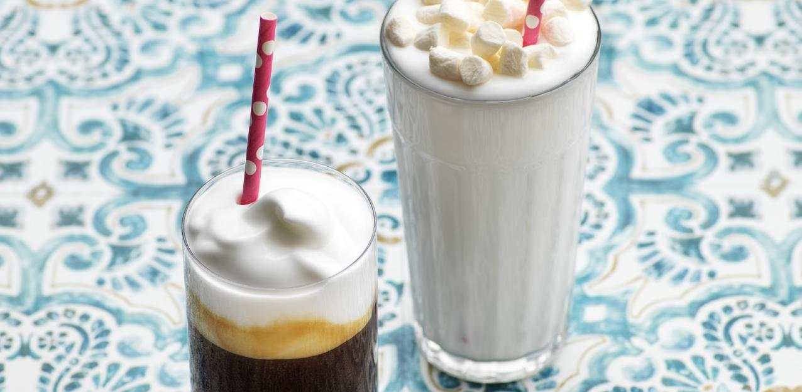
Let Beyond the bean
Solve These Pain Points
Confidential ©Beyond the Bean 2025

Slide 9
BEYOND THE BEAN SOLVES THESE PAIN POINTS
Don’t sell syrups, sell signature drinks
VERSATILITY:
EASE:
PROFITABILITY:
SUSTAINABILITY:
One Product, Multiple Drinks
Simple, Fast, Consistent, and Scalable
More Sales,
Higher Margins
Zero Food/Ingredient Waste, Maximum Impact
Transform one
Sweetbird syrup
or Zuma powder into
multiple drink variations.
No need for multiple new products
Create bespoke signature drinks and seasonal offerings that stand
out from competitors.
Minimal training required—easy recipes and fast preparation.
Blendtec blenders for
cold foams, smoothies,
and shakes with ease.
Customisable solutions
to fit your menu, staff,
and equipment.
Blended speciality drinks justify a higher price point.
Create a buzz with increased social media engagement and visibility
Cost-effective ingredients with long shelf life, reducing waste.
Customisable options = upselling opportunities.
100% recycled bottled, and widely recyclable packaging.
Efficient storage —ambient temperature storage saves energy.
One bottle of lemonade syrup replaces 44 single use plastic bottles
Confidential ©Beyond the Bean 2025

Slide 10
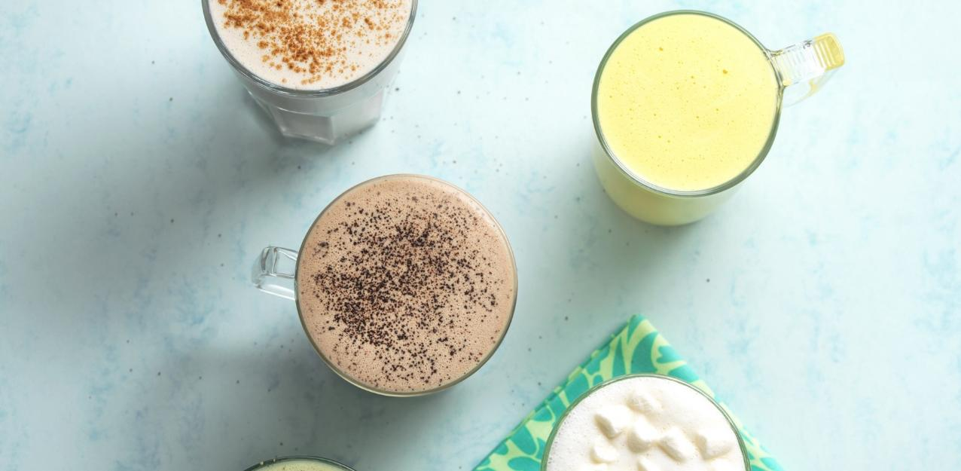
/
Beyond the bean creates
Award winning brands
Confidential ©Beyond the Bean 2025

Slide 11
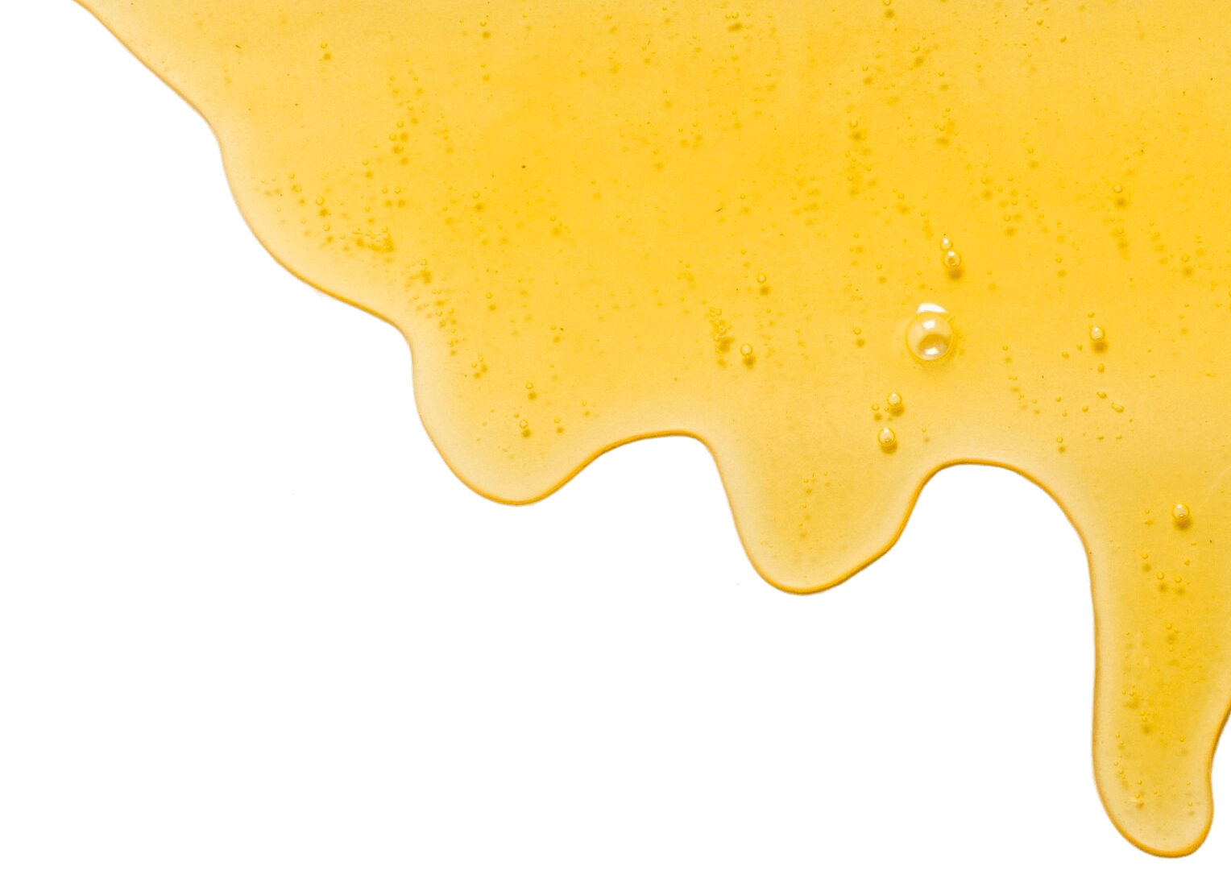

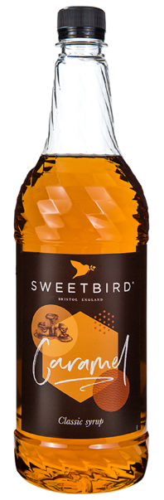





Your Cold Drinks Menu
THE POWER behind
60+ flavours across 7 varieties
Quick and easily made to order
One product, endless recipe opportunities
BRCGS AA Graded manufacturing
Made in the UK
Free from GMOs
Sweetbird SYRUPS:
Don’t sell syrups,
sell signature drinks!
No artificial colours
No single use plastic bottles
100% recycled plastic bottles
Storage at ambient temperature
Authentic
flavours
Vegan Society
Approved
Confidential ©Beyond the Bean 2025

Slide 12


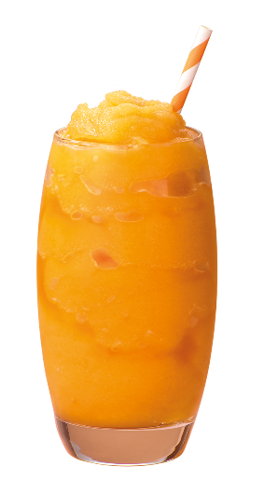
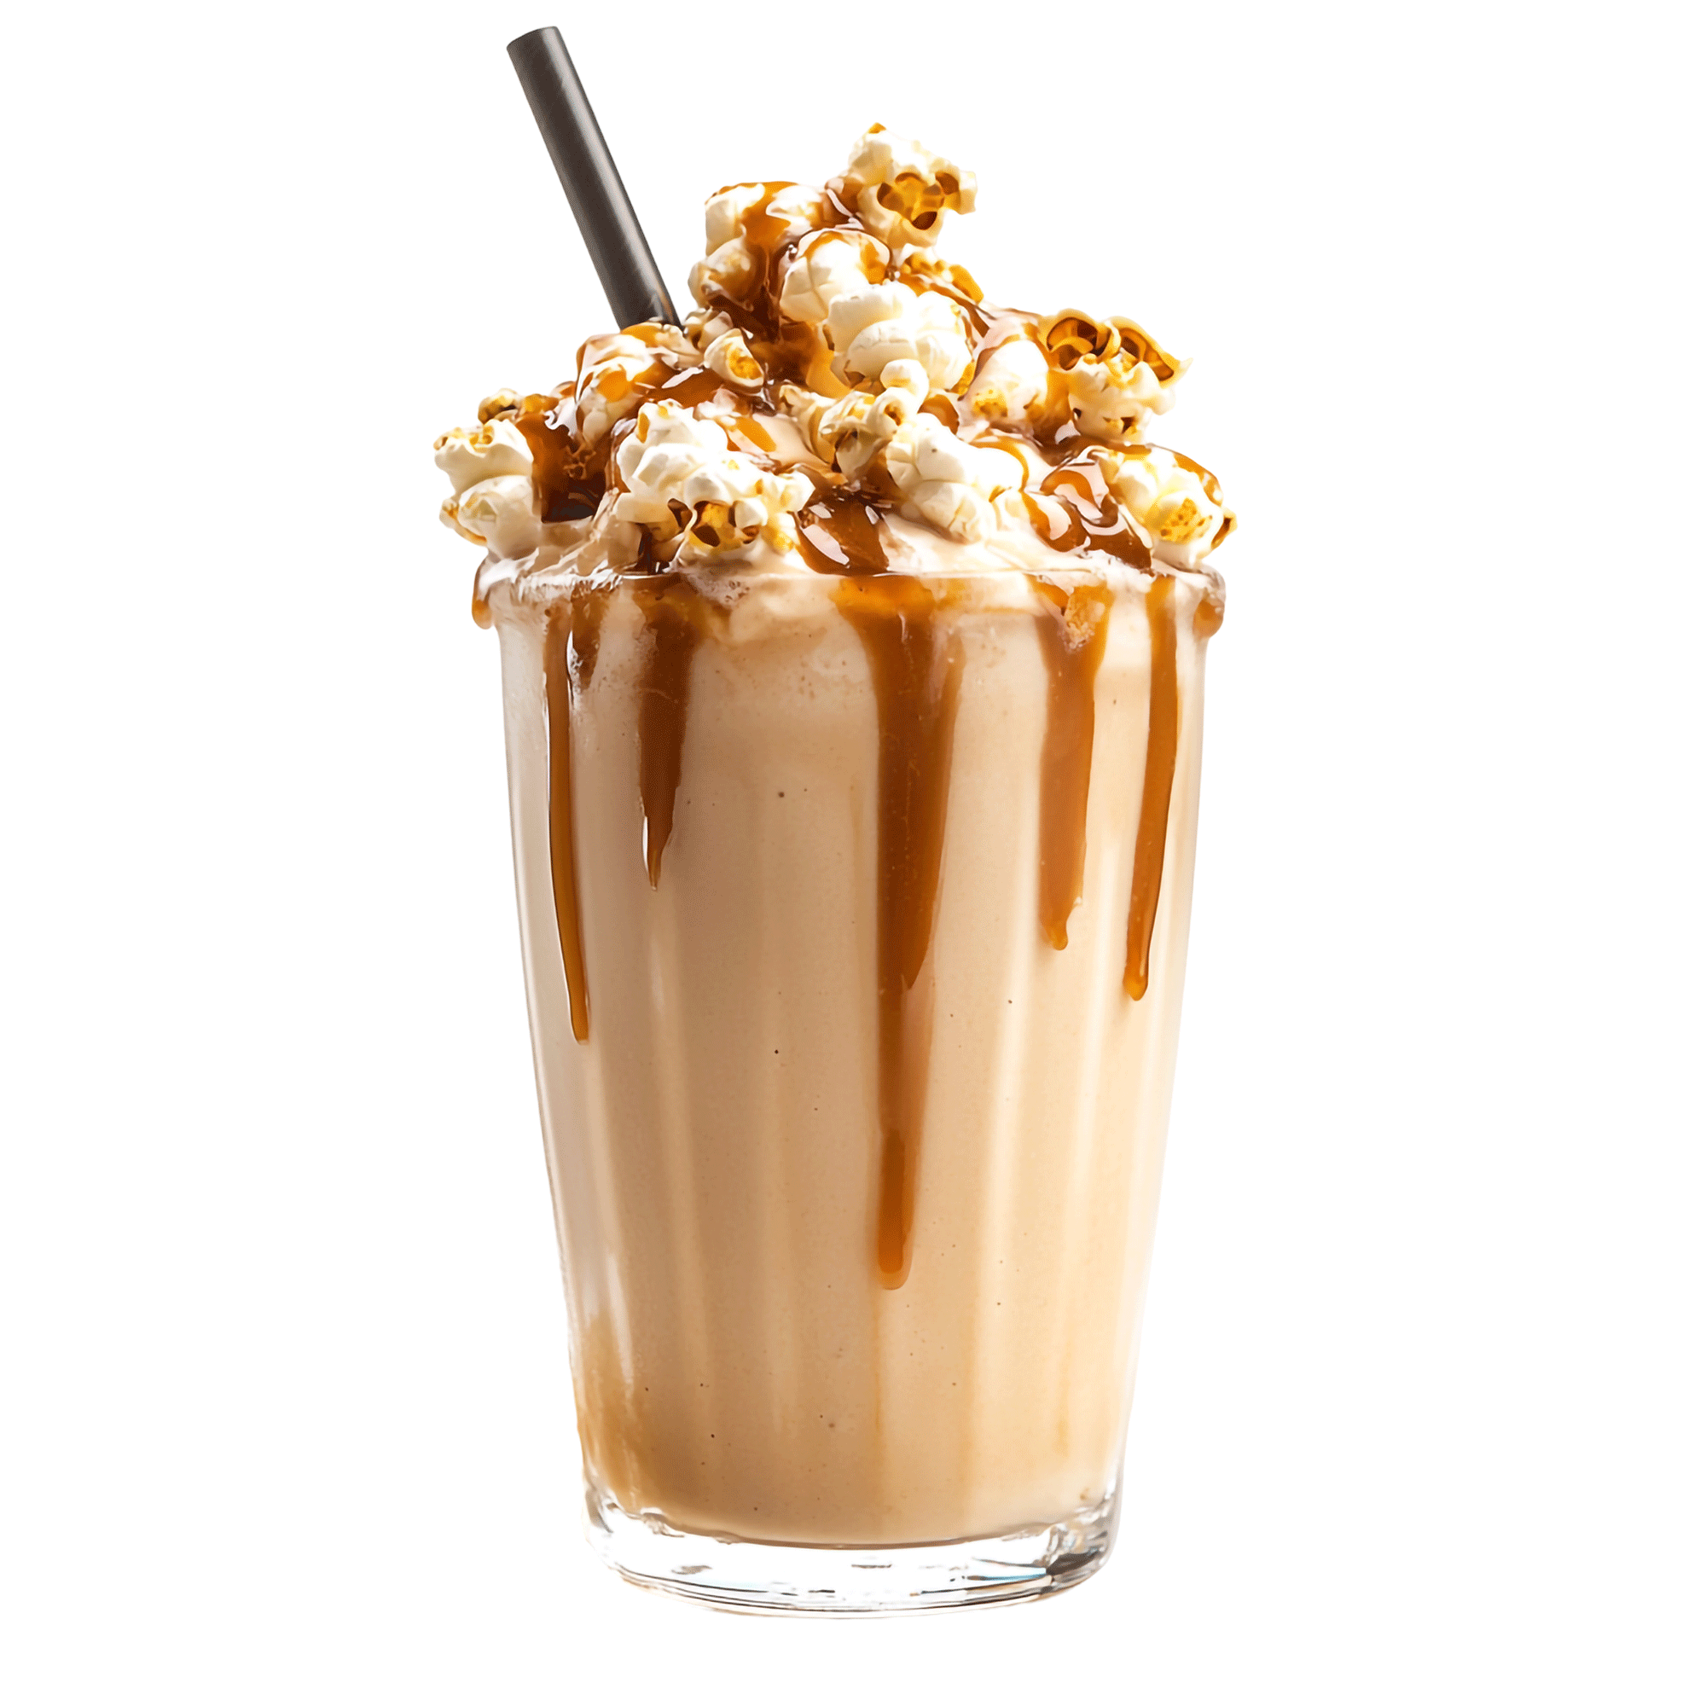
PURÉES
SMOOTHIES
Shakes & FRAPPÉS
Big on Fruit,
Big on Versatility – Perfect for milkshakes, sodas, cocktails, mocktails, and granitas.
Super-Speedy
& Easy-to-Use –
Ready to mix, blend,
and serve in seconds.
Packed with Real Fruit – Natural sweetness and bold flavours in every drop.
Pure Fruit Goodness Made with real fruit and juice for a rich, refreshing taste.
Zero Waste,
Maximum Convenience –
No peeling, washing, or prep—just pour and blend.
Easy Storage
& Even Easier Prep –
A long shelf life means fresh smoothies, always on demand.
Indulgent, Smooth & Ready in Minutes – Luxuriously thick and smooth with every blend.
Premium Ingredients, Expertly Selected – Crafted to deliver
the perfect balance
of flavour and texture.
Effortless to Prepare – Just blend with ice and milk for instant frappé perfection.
Your Cold Drinks Menu
THE POWER behind
Sweetbird smoothies, purées and frappés:
For each product,
endless possibilities…
Confidential ©Beyond the Bean 2025

Slide 13

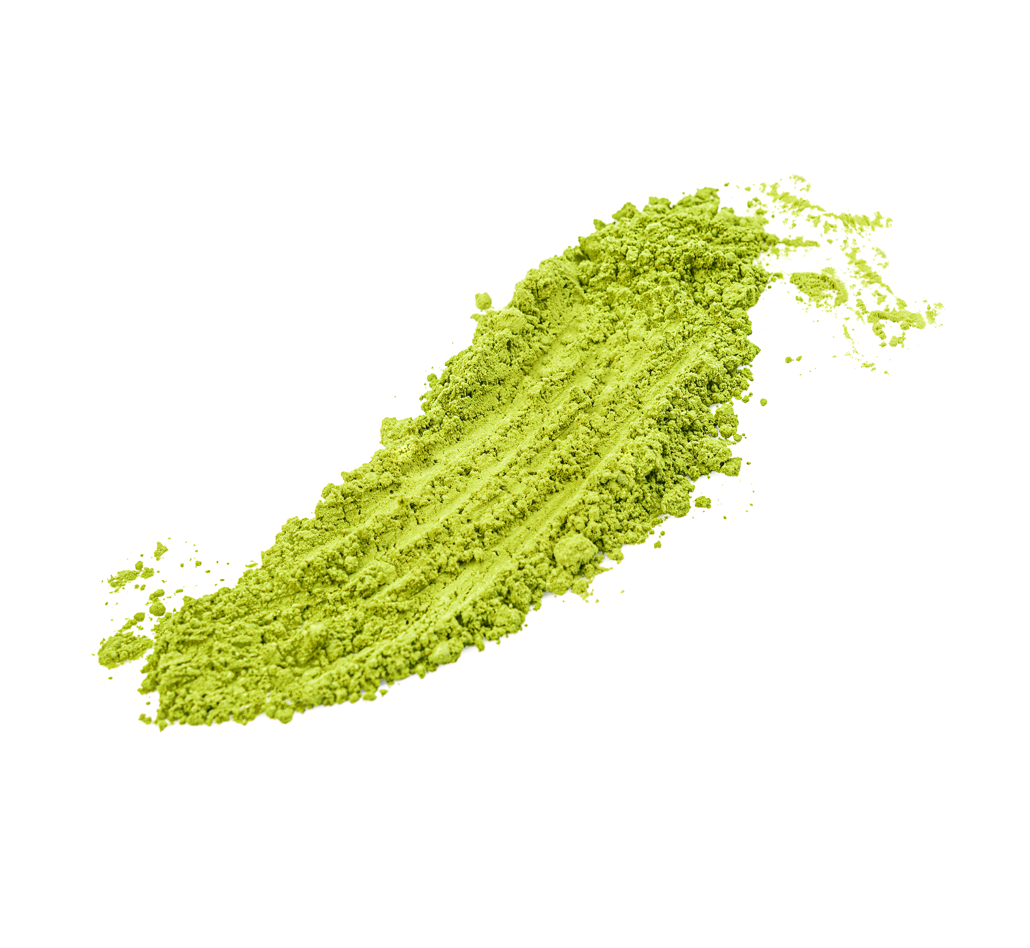
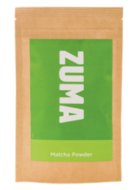
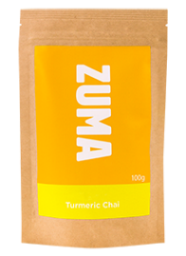



20 years
Diverse
Premium
Your Cold Drinks Menu
of expertise in perfecting ingredients for drinks
range including White, Dark, Thick, Single Origin and Original Hot Chocolates.
sourcing – Organic, Fairtrade, and Single Origin varieties.
THE POWER BEHIND
More
Pure
than chocolate – includes a selection of sauces, chai, toppings and plant powders.
ingredients – no artificial additives in any of our powders for authentic,
high-quality flavour.
transform your iced drinks menu with the drinking chocolate revolution
Premium chocolate, chai, sauces, plant powders and toppings for unique drinks.
Confidential ©Beyond the Bean 2025

Slide 14

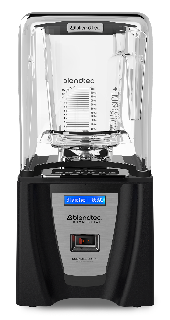
Powerful Motors
Blendtec Blenders feature industry-leading motors, effortlessly handling ice, frozen fruits, and dense ingredients to deliver consistently smooth beverages.
Robust Construction
Built to withstand high daily demands, ensuring longevity and reliability in busy coffee shop environments.
Behind Your Cold Drinks Menu
THE POWER
Preprogrammed Cycles
With up to 42 customisable blend cycles, achieve perfect consistency for smoothies, frappés, and more with a single touch.
User-Friendly Interface
Modern touch controls and easy-to-clean designs streamline operations, allowing
staff to focus on customer service.
Blendtec commercial blenders
Reinvigorate your cold drink line up
Sound Reduction
Models like the Stealth 885 incorporate advanced sound enclosures, allowing blending at the noise level of normal conversation—ideal for maintaining
a pleasant café atmosphere.
Industry-leading after-sales support
Including troubleshooting assistance, expert phone consultations, and onsite dedicated service centre, ensuring swift and comprehensive service
Confidential ©Beyond the Bean 2025

Slide 15
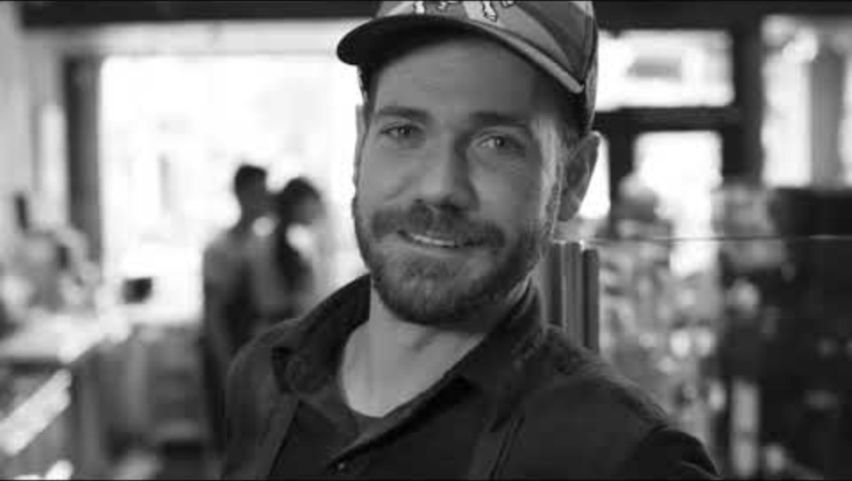
This is why Peet’s Coffee uses Blendtec
If video doesn’t play automatically, please click here: https://youtu.be/yZwWltsYG1w

Slide 16
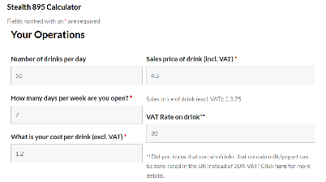

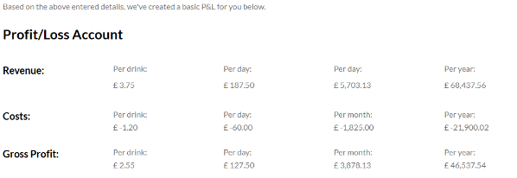
Blendtec ROI calculator
If you are thinking about investing in a new commercial grade blender it is useful to see how the right choice will boost your business’ profitability.
Behind Your Cold Drinks Menu
THE POWER
Example P&L for a new Blendtec blender
CLICK HEREto go the to the online ROI Calculator
Blendtec commercial blenders:
What’s the ROI?
A Blendtec Stealth 885 can pay for itself in six months with just four drinks a day—or in under a week
for high-volume smoothie bars.
Confidential ©Beyond the Bean 2025

Slide 17
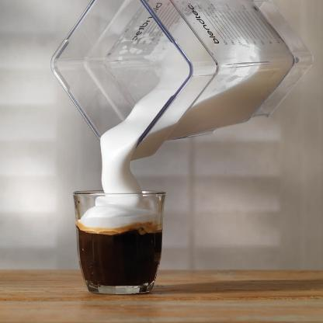
Cold foam has seen
a surge in popularity
PERFECT COLD FOAM in 18 seconds
EASY & IMPRESSIVE
UK market valued
at £10 million
Blendtec powers the Cold Foam revolution - be a part of it!
£
Projected to reach
£26 million by 2027
Cold foam is a show-stopper in how a drink
is presented, however they’re deceptively easy to make and can generate amazing margins.
Cold foam is the perfect way to get creative.
Cold foam can be flavoured with an unlimited range of ingredients and can be coloured with matcha, beetroot powder or turmeric (from Zuma) to make delicious and stunning drinks.
Next: Get creative!
Syrup: 2 pumps
Sauce: 2 pumps
Smoothie: 30ml
Purée: 30ml
Matcha: ½ mini scoop
Turmeric: ½ mini scoop
Dark Cocoa: ½ scoop
How to make Cold Foam
1. Pour 150ml of cold skimmed milk into to a Blendtec cold foam jar
2. Blend on ‘small milkshake’ setting for 18 seconds
3. Pour foam into glass or to top your latest creation
Source: Blendtec 2025. Confidential ©Beyond the Bean 2025

Slide 18


WE ARE
BEYOND
THE Bean
Confidential ©Beyond the Bean 2025

Slide 19



what our partners say
“Beyond The Bean’s speed of response and service expertise helped us launch great drinks, fast.”
“Our sole supplier for syrups across our coffee and cocktail range; fantastic range and new product development.”
Hannah McKay Caffe Nero
“Sweetbird’s innovations
have transformed our seasonal drink campaigns.”
Michael Warren
Whitbread
Tina Ellevold Karlsen
Solberg & Hansen
Confidential ©Beyond the Bean 2025

Slide 20
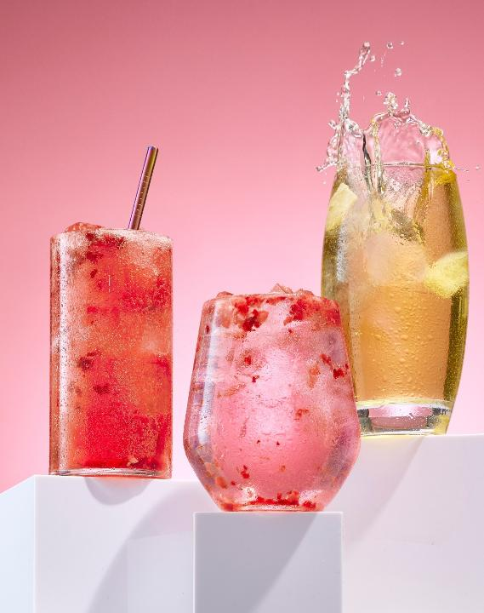
WHY choose
Revolutionising Cold
Drinks for Coffee Shops
Beyond The Bean?
Industry Experts
Founded by hospitality professionals who understand your challenges.
Premium, Award-Winning Brands
Sweetbird and Zuma for all your syrups, frappés, purées, smoothies, hot chocolates, chai, sauces, and plant-based powder needs.
Official UK Blendtec Commercial Importer
Offering high-performance blending solutions.
Beyond Products, We Provide Support
Helping you craft profitable, exciting menus.
Independent & Passionate
Committed to quality, sustainability, and constant innovation from a family-run business.
With our own AA BRCGS-accredited manufacturing facility,
we ensure consistency and excellence from brief to bottle.
At Beyond The Bean, we don’t just sell drinks —
we help shape the future of beverage innovation.
Confidential ©Beyond the Bean 2025

Slide 21

We think
Beyond The Bean
Independent & Uncompromising
We do things our way,
with quality and creativity
at the core.
Trusted Worldwide
Our products are loved in over 50 countries, from specialty coffee roasters to global brands.
More than a COMPANY –
a community of drink innovators
Hands-On Experience
We’ve been behind the counter, in the kitchens, and
on the frontlines of hospitality.
Real Support, Real People
No bots, no scripts —
just experts ready
to help you grow.
At Beyond the Bean we live and breathe drinks. We’re not just manufacturers; we’re creators, problem-solvers, and trendsetters.
Since 1997, we’ve been crafting the future of beverages, ensuring our customers stay ahead of the curve.
Innovation First
From syrups to sustainability,
we’re always pushing boundaries.
More than Just Products
Hands-on training, marketing materials, menu development,
and custom product creation
to maximise drink menus.
Confidential ©Beyond the Bean 2025

Slide 22
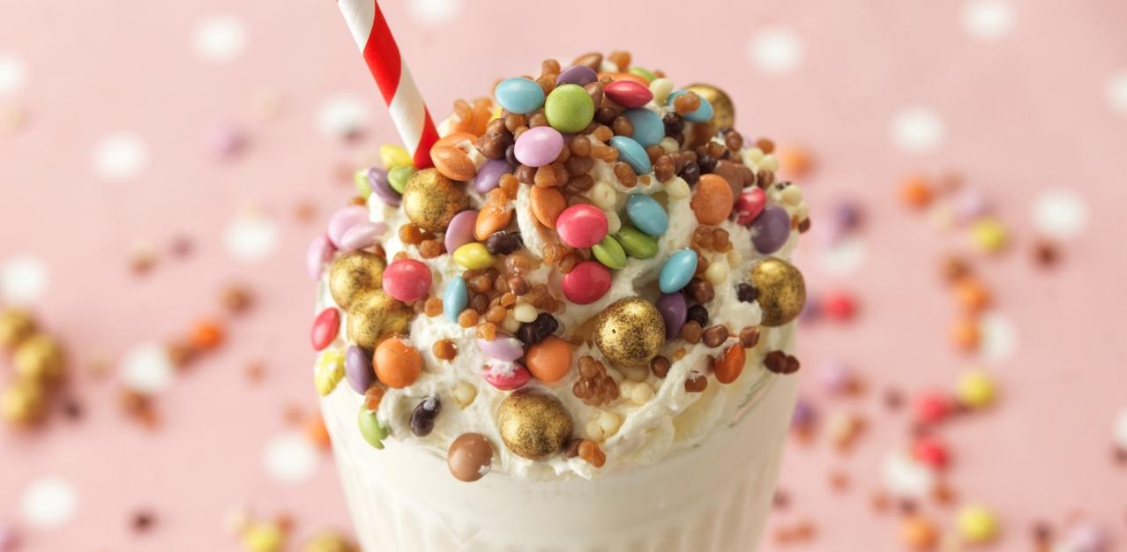
To wrap up….
Confidential ©Beyond the Bean 2025

Slide 23
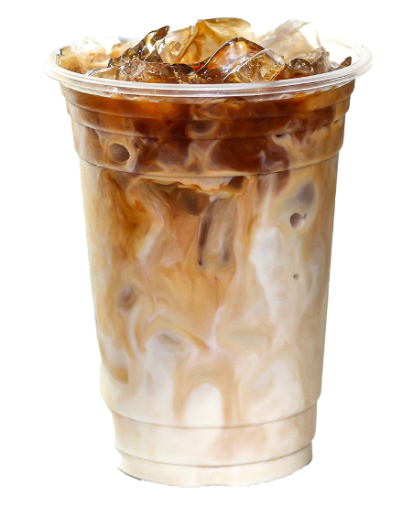
Think Beyond Coffee.
Think Cold.
Think Beyond The Bean.
Cold Drinks drive growth, profits, and customer engagement. Are you ready?
Why Cold?
Why Now?
Around 70% of coffee shop menus are not just coffee
Think flavoured, blended, iced!
Customers demand variety
56% of UK coffee shop visitors say iced drinks need more excitement!
High-margin, all-day appeal
blended drinks, iced teas,
and frappés sell year-round.
Sustainability is key
Zero food waste, low storage, and recyclable packaging options.
Confidential ©Beyond the Bean 2025

Slide 24
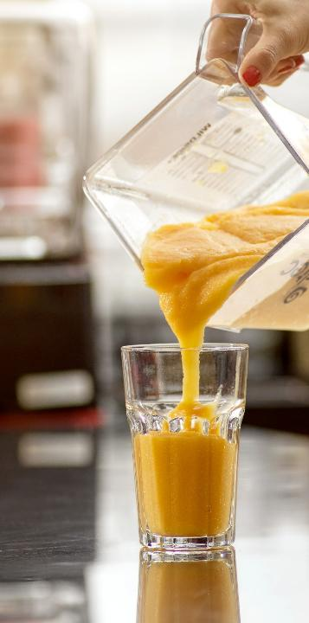
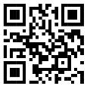
hello@beyondthebean.com
+44 (0) 117 953 3522
Maximise profits with exciting cold drinks
LET’S TALK!
Partner with Beyond the Bean for an effortless, profitable,
and sustainable menu.
Connect with us today—we can
help with menu creation, staff training, and product solutions.
Let’s talk! Get in touch
to transform your cold
drinks menu.
hello@beyondthebean.com
+44 (0) 117 953 3522
Find out more
Confidential ©Beyond the Bean 2025

Slide 25
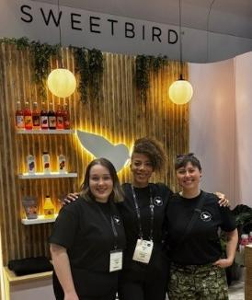
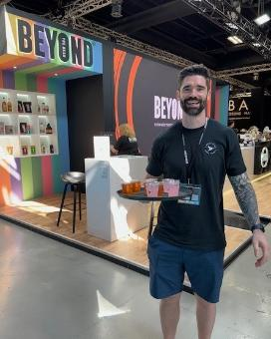
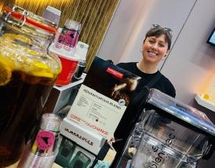
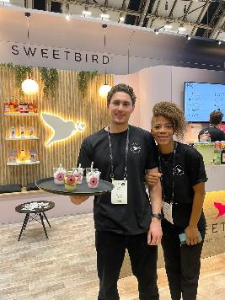
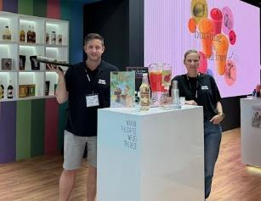
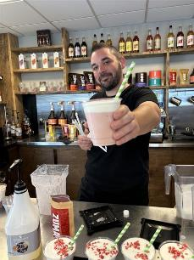
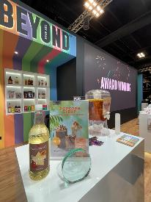
YOU DO THE COFFEE,
WE DO THE REST!
Confidential ©Beyond the Bean 2025

